Slide 1

Psychology and Motivation 1:
Addiction and Education

Slide 2
Why Addiction and Education?
At first glace these two topics seem unrelated; however both have to do with playing video games and motivation.
Part One of this lecture gives a brief overview about gaming ‘addiction’—its definitions and formal case studies/examples.
Part Two examines what players learn—both formally/informally and deliberately/accidentally from video games.
The connection is simple: video games are highly compelling (I think we can all agree). If we could only use their ‘compelling’ properties for educational purposes, we would have one of the most powerful motivators for learning, like, ever—right? Could students (in theory) be ‘addicted to learning?’ Maybe. Maybe not.
Next week we will take a closer look at player motivation based on player types and game mechanics.

Slide 3


Slide 4

It’s easy to make fun of this stuff; however for those of us who have actually been in love/a long term relationship, this tale is both tragic and heartbreaking.
The line that always gets me is ‘I am not in love with him anymore but I do love him’—the sense of being trapped is palpable.

Slide 5


Overview of Gaming Addiction
“Most people can play most games without becoming addicted, just as most adults can drink alcohol on occasion without becoming addicted or gamble from time to time without losing their life savings” (CBC)
A little less than 10% of gamers develop extreme gaming habits where accomplishments in a virtual world become the priority and affect advancements in the real world.
Quite simply: There is no epidemic of people dying from playing too many video games and many of the discussions around gaming addiction are sensationalized and are used to demonize games.

Slide 6

Defining Addiction
In 2007, the American Psychiatric Association reviewed whether or not video game addiction should be added in the new Diagnostic and Statistical Manual of Mental Disorders (DSM) to be released in 2013.
The conclusion was that there was not enough research or evidence to conclude that video game addiction was a disorder (although Internet Gaming Disorder is a topic requiring further research).
Number of completed studies is limited.
Addiction to video games does not have the same repercussions as other addictions—such as drugs, alcohol, or gambling (276).
Crime and debt are not side effects of compulsive gaming (276).

Slide 7


Mark Griffiths
“Videogame addiction does exist but…only affects a small minority of players. There appears to be many people who use video games excessively, but are not addicted as measured by [scientific] criteria” (276). Professor Mark Griffiths, Psychology.

Slide 8

7%
In a recent study, (based on criteria to diagnose compulsive gambling) Griffiths and Davies estimate that 7 percent of the gaming population is addicted, based on a definition of “addiction” as playing more than 30 hours a week (or 4.2 hours a day) (276).
Does this make you an addict? How often do you play?

Slide 9
Singapore Study
A more recent study (2011) was conducted in Singapore using 3034 school children.
Was a 2 year longitudinal study.
Concluded that 9% of gamers are addicted.
Also offered insight into causality: lower social competence and greater impulsivity act as risk factors.
Outcomes of pathological gaming were “depression, anxiety, social phobias, and lower school performance.”
Teen gaming addiction in Singapore

Slide 10
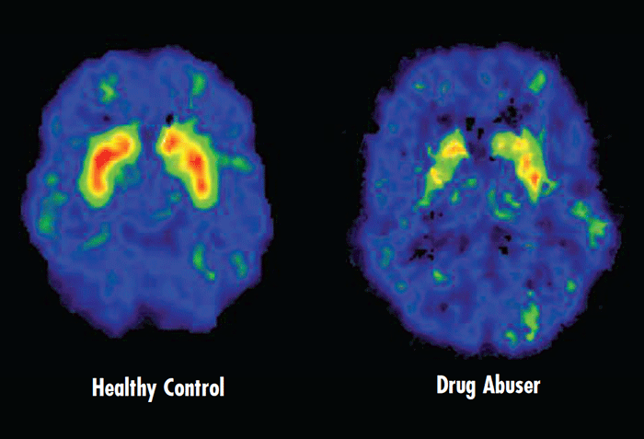
Not “Addiction” but “Compulsion”
Gaming itself is not addictive – addiction is the fundamental alteration of brain chemistry and games have never been demonstrated to do that.
They are “compelling.”
Game compulsion doesn’t exist in isolation
Game compulsion applies to people that would typically show compulsion to many other forms of entertainment or activities (Type A personalities)

Slide 11
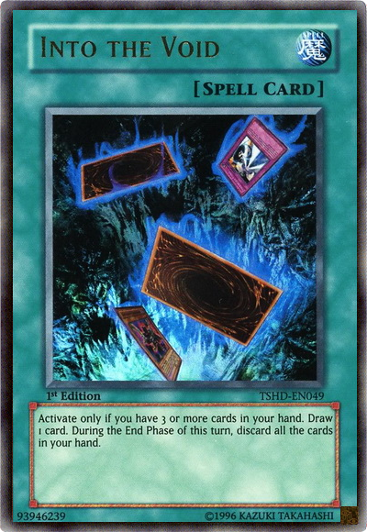
The Real Question
BAD Question: Are games addictive?
Better Question: What void does compulsive gaming fill? How can the player change, fix, or fill those voids in better ways.
Voids:
Low-self esteem (work, school, body image)
Poor social or family life
Games provide powerful incentives for feelings of success and acceptance.

Slide 12
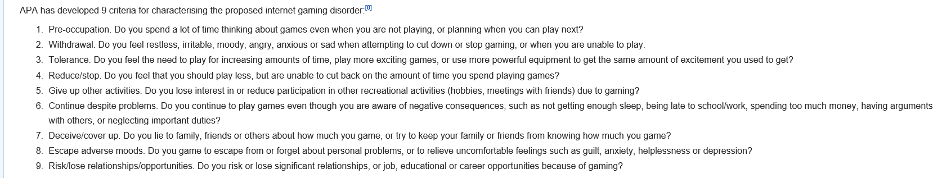
Symptoms of Addiction (er, compulsion)
Withdrawal: restlessness, vivid dreams of their game, depression, excessive sleep and anger.
Denial: lying about how much they play.
Disruption of Life: Estimated that 6 to 20% of gamers exclude essential activities like work, family activities, school and sometimes sleeping and eating.

Slide 13

Many game addiction ‘freak-outs’ ont eh internet are fake—this one seems genuine.
It’s sad, funny, and pathetic all rolled into one.
I suppose one argument is that the parents are to blame—they created a monster and now have to deal with the consequences.
YouTube - WoW player scolded by parents over Ventrilo

Slide 14


Case Study: Shawn Woolley, Wisconsin, 2011
“Addicted” to Everquest.
According to his mother, his personality changed after starting to play Everquest. He became withdrawn, anti-social, and depressed.
Played for 1.5 years.
Killed himself at age 21 while the game ran on his computer.

Slide 15
Sony Online Entertainment CEO John Smedley, one of the creators of EverQuest
"When I spoke with Ms. Woolley, I expressed my condolences. And it's really one of those terrible things that happens. And there's just nothing to suggest that EverQuest had any role in his death. EverQuest is a game. And I don't see any connection between a form of entertainment and somebody's tragic suicide. It's entertainment. Is a book dangerous? Is a TV show dangerous? I think the answer is no. People need to take responsibility and say, 'Hey, you know, this is too much. Enough's enough.' It's a game."

Slide 16


Case Study: Dead Infants, South Korea, USA.
In 2009, Kim Sa-rang, a 3-month-old Korean child, died from malnutrition after both her parents spent hours each day in an internet cafe raising a virtual child on an online game, Prius Online.
Gregg J. Kleinmark, 24, plead "guilty to two counts of involuntary manslaughter". He left fraternal twins Drew and Bryn Kleinmark unattended in a bathtub for 30 minutes, in order to go three rooms away and play on his Game Boy Advance.
In 2011, Rebecca Colleen Christie sentenced to 25 years in jail for allowing her 3 year old daughter to starve to death while she played WoW.

Slide 17

Lee Seung Seop, South Korea, 2005
Played StarCraft for almost 50 consecutive hours.
Went into cardiac arrest from both exhaustion and dehydration.
He died shortly thereafter at a local hospital.
Earlier he had been fired from his job for missing work to play computer games.
More than 15 million people, or 30% of the population, are registered for online gaming in South Korea.

Slide 18


Daniel Petric, Cleveland, USA
Shot his parents, killing his mother, after they took away his copy of Halo 3 in October 2007.
Daniel would sometimes play the game for up to 18 hours at a time without taking a break.
After his parents found out that he had gone against their wishes and purchased the game, they immediately took the game away and locked it in a safe that also concealed a 9mm Taurus PT-92 handgun.
On 16 June 2009, Petric was sentenced to 23 years to life

Slide 19


Brandon Crisp, Barrie, On, 2008.
“Addicted” to Call of Duty 4.
Because the game was affecting his school work and social life, his parents confiscated his Xbox 360.
Brandon threatened to run away that day.
3 weeks later, Nov 9, 2008, his dead body discovered.
“A smart kid with a drive to succeed in all things, he was too small to do well in his beloved hockey. Video games became his substitute for sports, something he could excel at competitively, albeit to the detriment of a normal life away from his Xbox.” (Toronto Sun)

Slide 20


Alexandra V. Tobias, Jacksonville, 2010
Woman arrested after the death of 3-month-old Dylan Lee Edmondson. She told investigators she became angry because the baby was crying while she was playing FarmVille.
Sentenced to 50 years in prison, but….
Mother died in 2008
Suffered from post-partum depression
Was raped
History of family problems

Slide 21

Government Response
Government Intervention?
South Korea, China, the Netherlands and the United States have opened treatment centers.
Internet games operating in China must require that users identify themselves by ID numbers. After 3 hours, players under 18 are prompted to stop and "do suitable physical exercise." If they continue, their characters gain 50% of the usual experience. After 5 hours, their characters gain no experience at all.

Slide 22

Huai’an Internet Addiction Treatment “Centre”
Estimated 24 million Internet addicts in China
$2,750/person for a six-month treatment.
Military-style treatment starts at 5 a.m. and, after a day full of exercise, calli­graphy and other mind-numbing courses, ends at 9:30 p.m
Patients have been beaten to death
Chinese Internet Addicts Stage Daring Boot Camp Escape

Slide 23

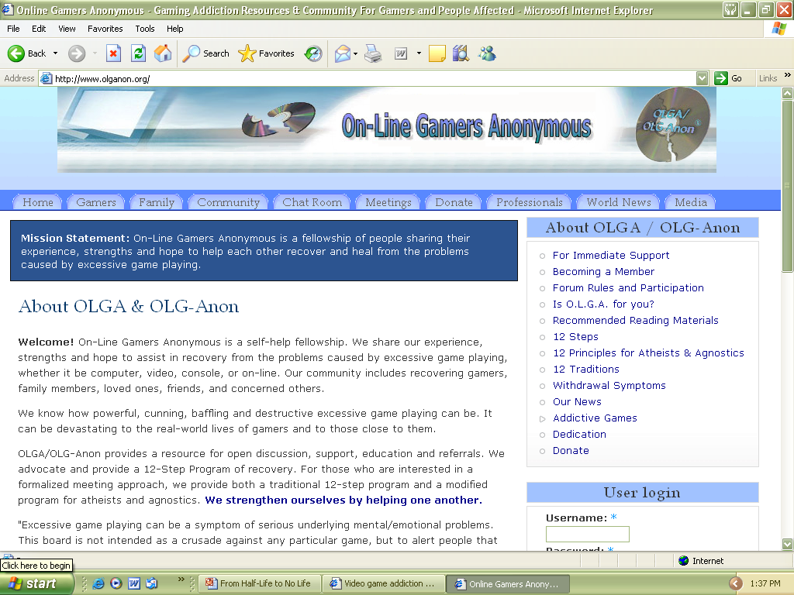
Many resources for gaming addiction/ compulsion exist.

Slide 24
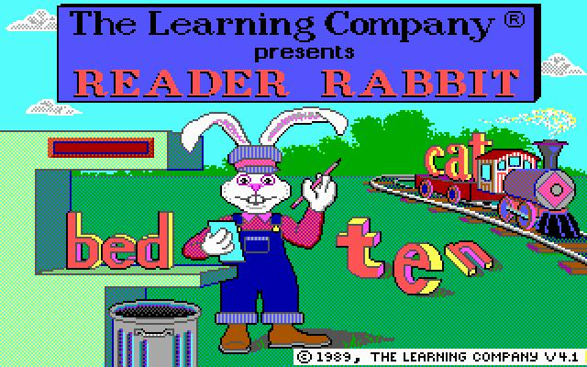
Psychology and Motivation:
Education

Slide 25

What do players learn from video games?
Propaganda?
Compassion?
Trivia?
Teamwork?
History, Geography, Science, math, etc?
Consumerism?
Can we get something more from video games besides “fun?”

Slide 26
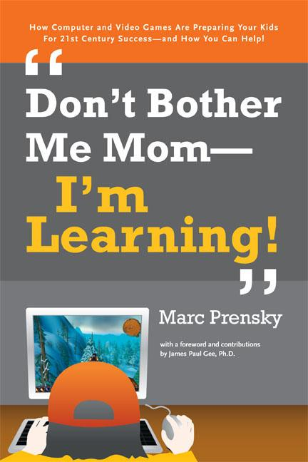
The Dilemma
Education based games often lack ‘fun’ and instead are all about the process.
Spell this word!
Solve this equation!
Entertainment games are often only about aesthetics and mostly lack the underlying design that makes you walk away feeling like you learned something.
Education games and entertainment games have split so far apart from each other that they’ve mostly lost their ability to use the benefits of each to strengthen each other.
Most “learning” in video games is often informal and anecdotal—a nice side effect as opposed to the main goal.

Slide 27
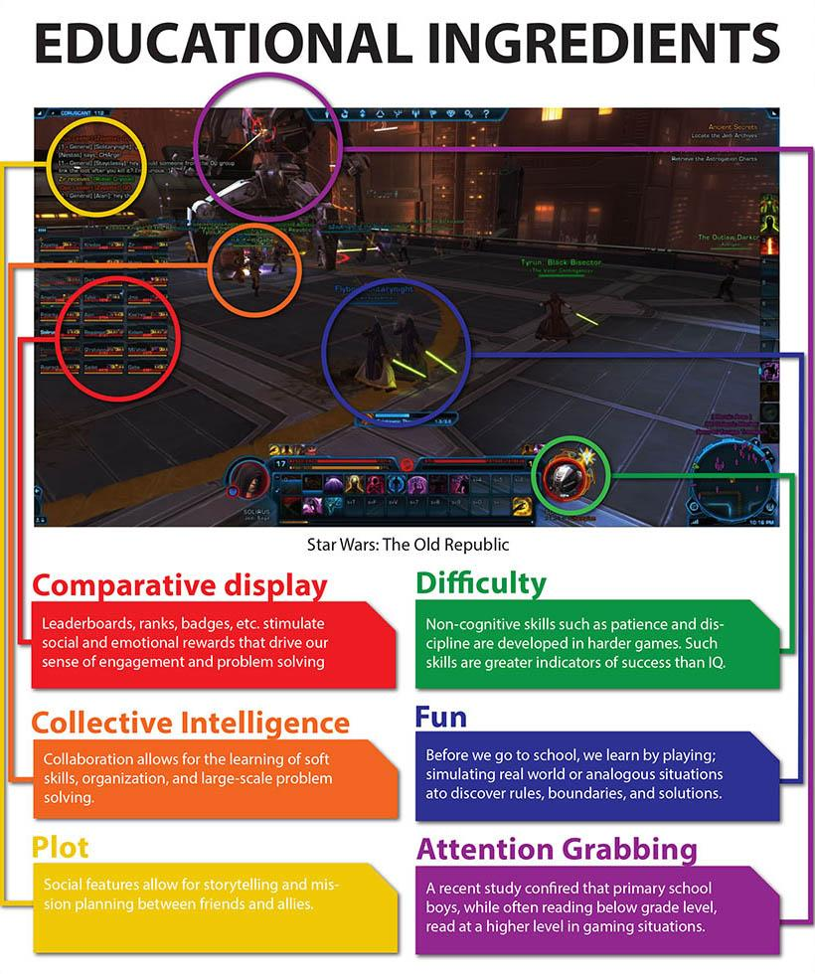
A common argument is that games teach you “non-direct” skills like patience, perseverance, and goal-setting.
The problem is that while these “skills” can often transfer from GAME TO GAME, they are not often transferred to real life—if they do transfer, it’s in superficial ways.

Slide 28
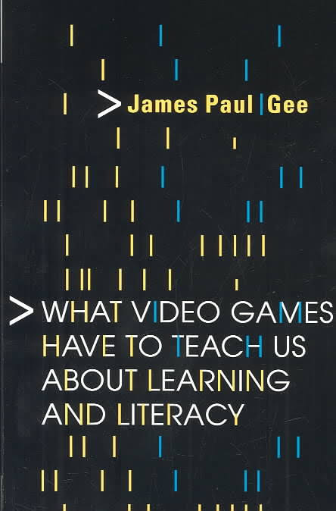


James Paul Gee
Video games, when they are successful, are very good at challenging players. They motivate players to persevere and simultaneously teach players how to play.
Gee began his work in video games by identifying thirty-six learning principles that are present in - but not exclusive to - the design of good video games
Work focuses on how these learning principles can be applied to the K-12 classroom

Slide 29
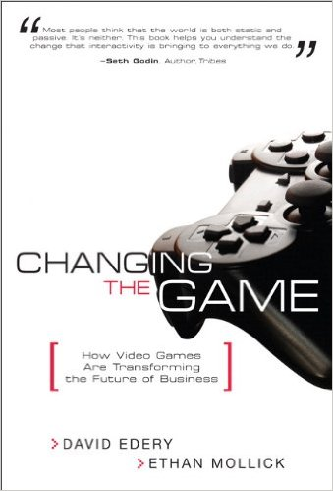

Informal Learning: Teamwork, Cooperation, and Social Engagement
Lost in all the talk about violence, addiction and griefing is the idea that video games can actually bring people together to interact, socialize, and cooperate (in a positive way (depending on the game).
The World of Warcraft family - YouTube

Slide 30

But what about formal learning? For example, can video games…
…influence you to join a political party?
…influence you to buy a brand?
…improve your knowledge of school related subjects?
…influence you to make the world a better place through activism and charity?

Slide 31
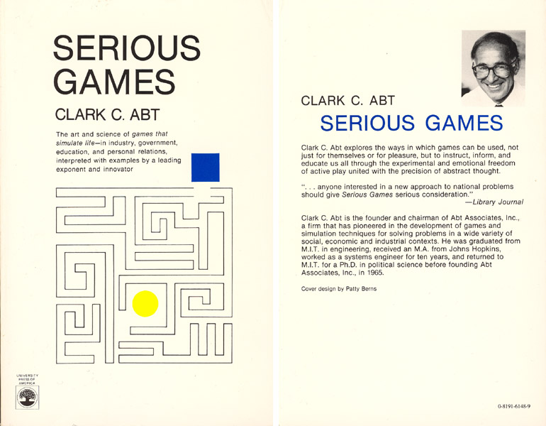
Landmark book that got the conversation started that video games can be used for something other than fun.

Slide 32

“Serious Games”
Refers to video games produced, marketed, or used for purposes other than pure entertainment:
Edutainment
Political/Military Games
Advertainment/ Corporate Games
Games-For-Change
Health/Therapy Games

Slide 33

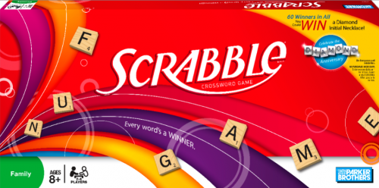
Traditional Games
Using games to teach people “stuff” is nothing new; however, video games provide an even more interactive, immersive, and desirable way to teach someone.

Slide 34
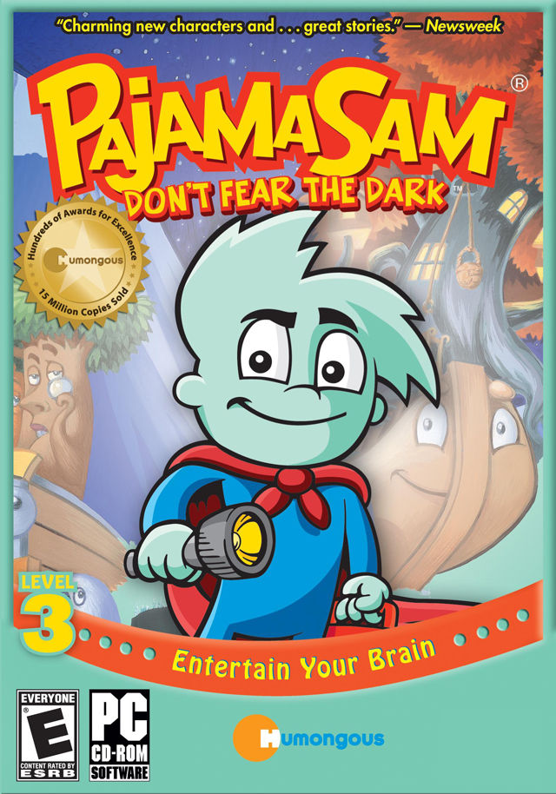
Edutainment: Two Types
Commercial educational video games
Focuses on teaching the player a specific skill: algebra, spelling, problem solving, among others.
Regarding “brain training” games: transferability is unproven—meaning just because you’re great at the memory game doesn’t mean you you’ll always remember where you put your car keys.
In fact, exercise and socialization are proven to have more impact on cognitive development.

Slide 35


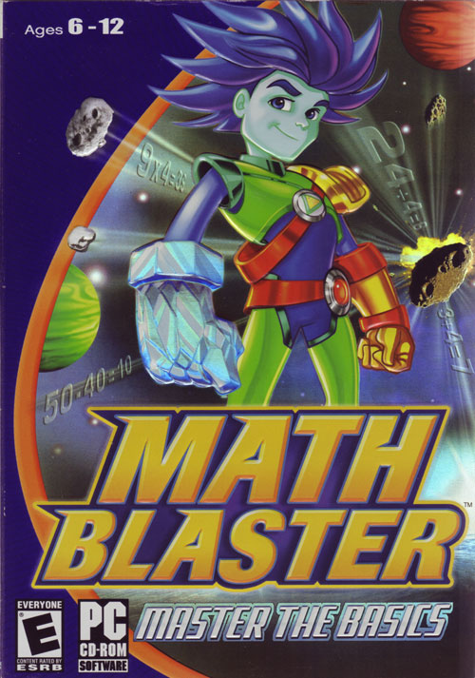
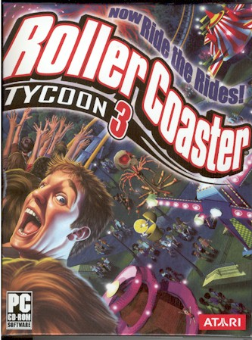

Slide 36


Slide 37
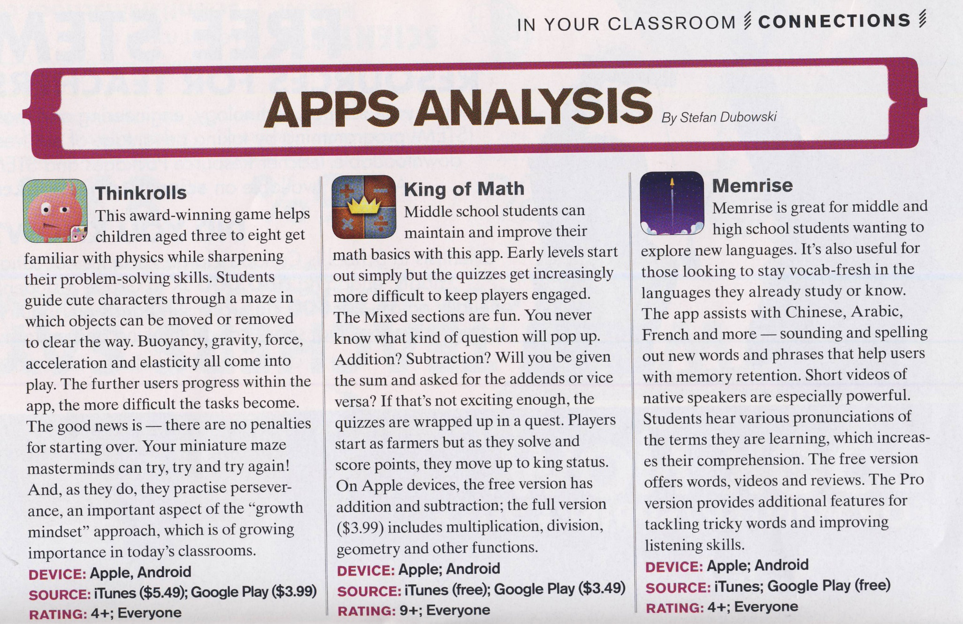
Edutainment Apps are all the Rage
The Ontario College of Teachers has its own magazine—Professionally Speaking—where they showcase the latest edutainment, complete with reviews.

Slide 38
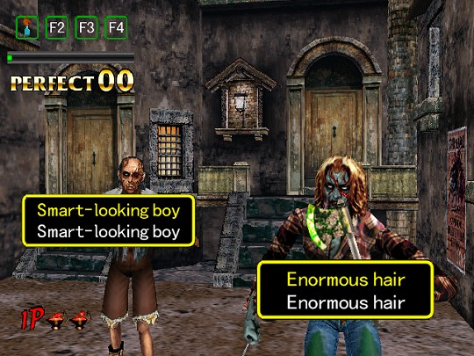
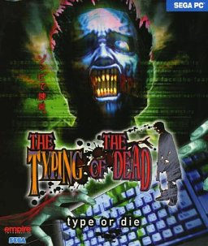
Screenshot from The Typing of The Dead—a game designed to better your typing skills—cool!

Slide 39



Slide 40

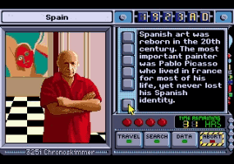
Where In Time Is Carmen Sandiego? (1989)
Players travel through time to collect clues and warrants necessary to capture Carmen Sandiego or one of her henchmen.
The goal of this game is to track Carmen's villains through history and arrest them and ultimately arrest Carmen herself.
Kind of like Doctor Who
Game ends when all 80 villains are captured
Game came with the New American Desk Encyclopedia and 28 page instruction manual.

Slide 41
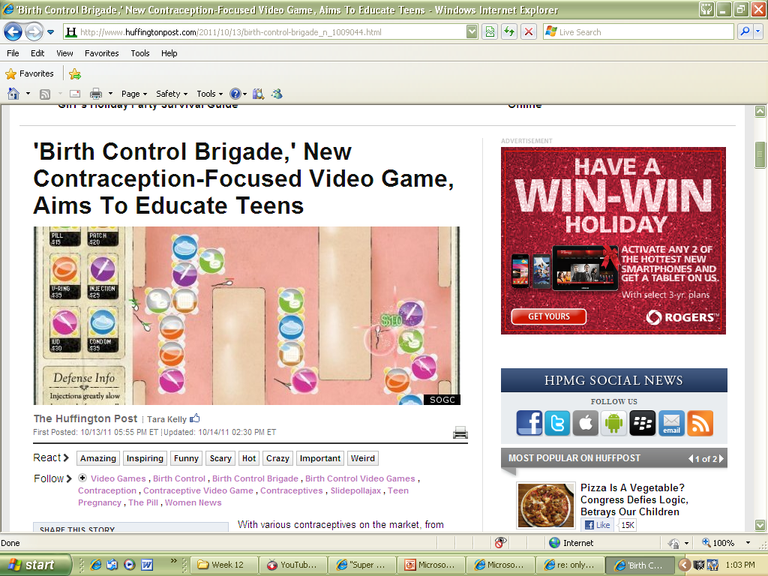

I played this poorly designed game; I didn’t learn much about birth control…
Birth Control Brigade

Slide 42
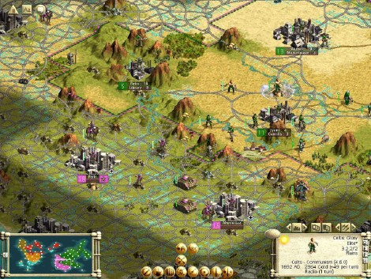


Commercial Entertainment (that can be educational)
Used haphazardly for education
Rarely focus on teaching skills mapped to a curriculum
Weakness: educational goals are indirect rather than direct
Strength: high player motivation
SimCity: Urban Planners and Engineers
Assassins Creed/Civilizations/War VGs: History
Rescue Bots: science (?)

Slide 43


Virtual Tourism?
Assassin’s Creed: Origins features a “Discovery Tour Mode” where ‘players’ can experience ancient Egypt free from combat mechanics (or as Ubisoft says free from “constraints or threats”).
Watch a body being mummified or tour ancient ruins (see next slide).
Certainly—and as long as the historical details are correct (see slide on Celopatra)—VGs can provide valuable educational simulations for students.

Slide 44
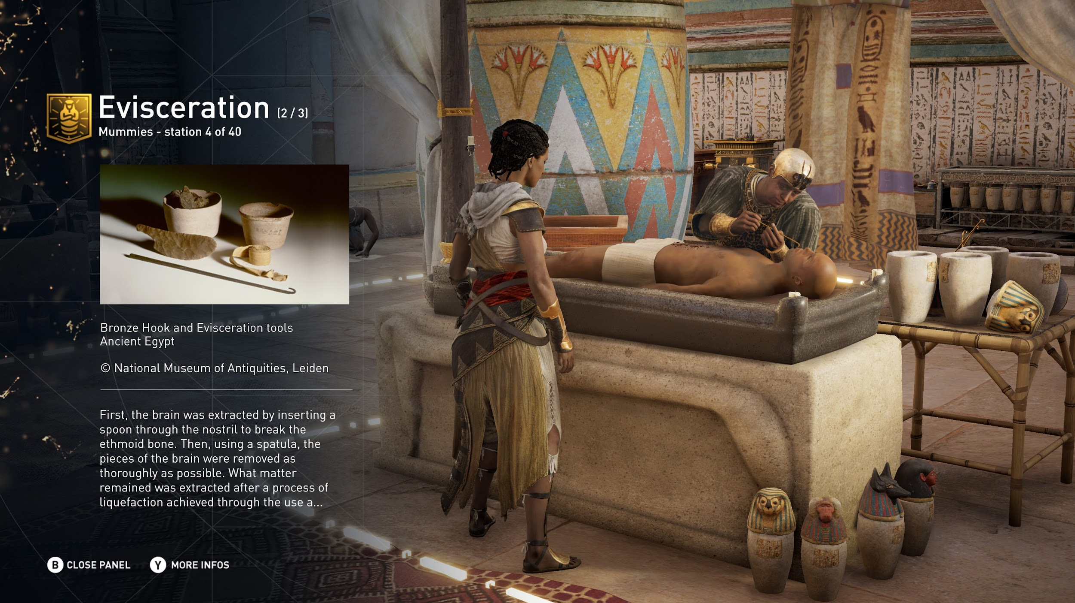
Cool right? But….

Slide 45
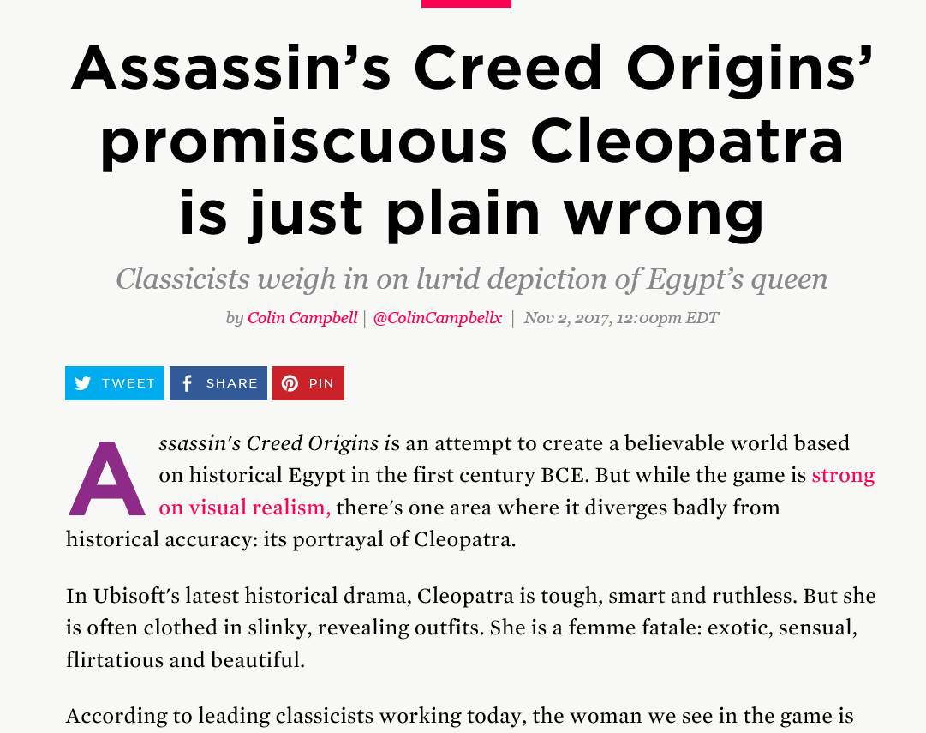
And right here is the problem: games can provide interactive educational simulations, but if their facts aren’t correct, misinformation is the result.

Slide 46


Ubisoft came under fire for AC 3 for much the same reasons…
Assassin’s Creed III video game distorts history - The Globe and Mail
“Assassin’s Creed III is set in 1765, and promotional material describes how, as “a Native American assassin, [you] eliminate your enemies with guns, bows, tomahawks, and more!” To suggest indigenous peoples rallied to the side of the colonists in their fight for freedom grotesquely twists the facts.”

Slide 47

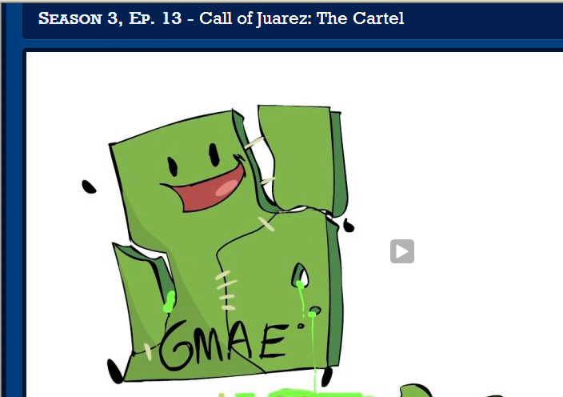
Racist? Historical Fiction? Propaganda?
Call of Juarez received moderate to above average reviews: however, as the below extra credits video shows, not only does the game get its facts wrong, but its presentation often leads players to incorrect conclusions about these realistic events.
Call of Juarez

Slide 48


Minecraft and Portal 2…in the classroom
Two mainstream games (the former more than the latter) used in the classroom to teach various concepts.
About Minecraft: “…a powerful engagement tool in mainstream subjects like math, science, social studies, and even language arts. The open-endedness of the game lends itself to teaching concepts like area, perimeter, and volume on the one hand, and plot structure and characterization in literature on the other.
About Portal 2: “Teach With Portals”—currently discontinued. BTW, can you spot the bloody writing error in the description!? UG….

Slide 49



Can games teach history and important social issues and events in the same way film has been doing for decades?

Slide 50

That Dragon, Cancer; Depression Quest; Papers Please
To repeat, possibly the greatest ‘learning’ tool from video games is their power for simulation and empathy. Players experience events they wouldn’t have access to in their ‘real’ lives and learn and identify with unique characters:
That Dragon, Cancer: …designed to have the player experience the low and high moments of cancer diagnosis in the style of a point-and-click game.
Depression Quest: interactive fiction game where you play as someone living with depression. You are given a series of everyday life events and have to attempt to manage your illness, relationships, job, and possible treatment.
Papers Please: As a border guard, the player must review immigrant and returning citizens’ passports and other supporting paperwork against a list of ever-increasing rules using a number of tools and guides, allowing in only those with the proper paperwork, rejecting those without all proper forms, and at times detaining those with falsified information

Slide 51

General Criticism of Edutainment
Low quality games that aren’t very engaging to play
Questionable content developed by opportunists
Feed the player information rather than encouraging curiosity and exploration
Almost none of the current edutainment titles are built on research that verifies their long-term educational benefits.
Gameplay for most edutainment has not changed since the 1980s!

Slide 52
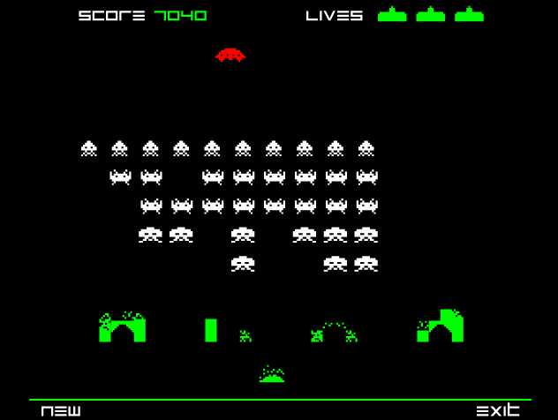
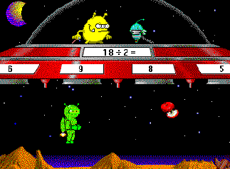
Little Intrinsic Motivation
Edutainment relies on extrinsic (from without) motivation: promise of rewards (ie: points) as opposed to intrinsic (from within) motivation such as a feeling of mastery.
Learning in edutainment is often “drill and practice” as opposed to a focus on “understanding.”

Slide 53

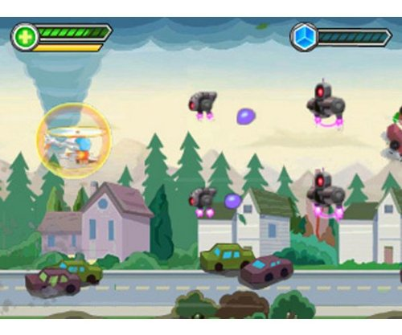
No Integrated Learning Experience
Edutainment is usually unable to integrate (combine) the experience of playing with the experience of learning—players often concentrate on playing rather than learning.

Slide 54
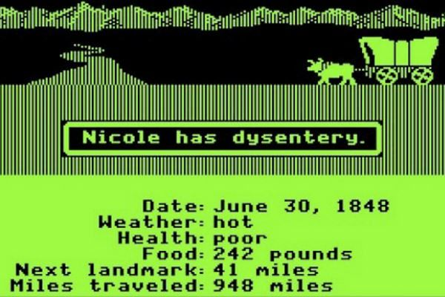

Simple Gameplay
Simple gameplay is fine for younger players, but outright boring and unchallenging for those brought up on Halo and COD

Slide 55


No Teacher Presence
Edutainment hardly demands anything from teachers and parents.
“The teacher is crucial to facilitating students’ appreciation of key experiences in the game and to expanding those experiences beyond the game world.” (235)

Slide 56

In-game tutorials are excellent examples of integrated learning: a player is taught a new concept and then must use this concept to proceed in the game. Edutainment MUST follow this example…and, um, be fun.

Slide 57
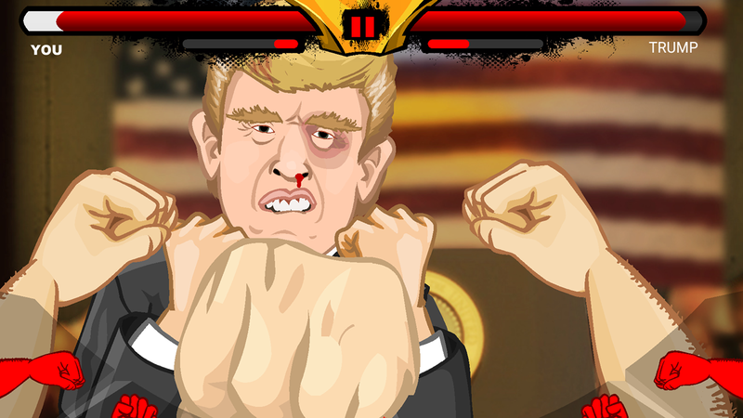
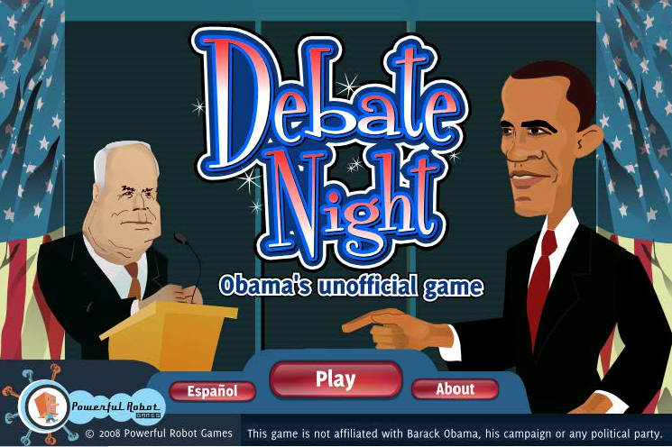
Political and News Games
Sometimes propaganda
Sometimes educational
Sometimes satire
The real question: will players ever get a meaningful game about politics?

Slide 58


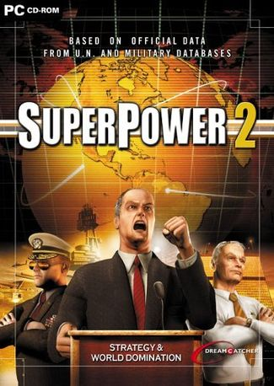

Slide 59
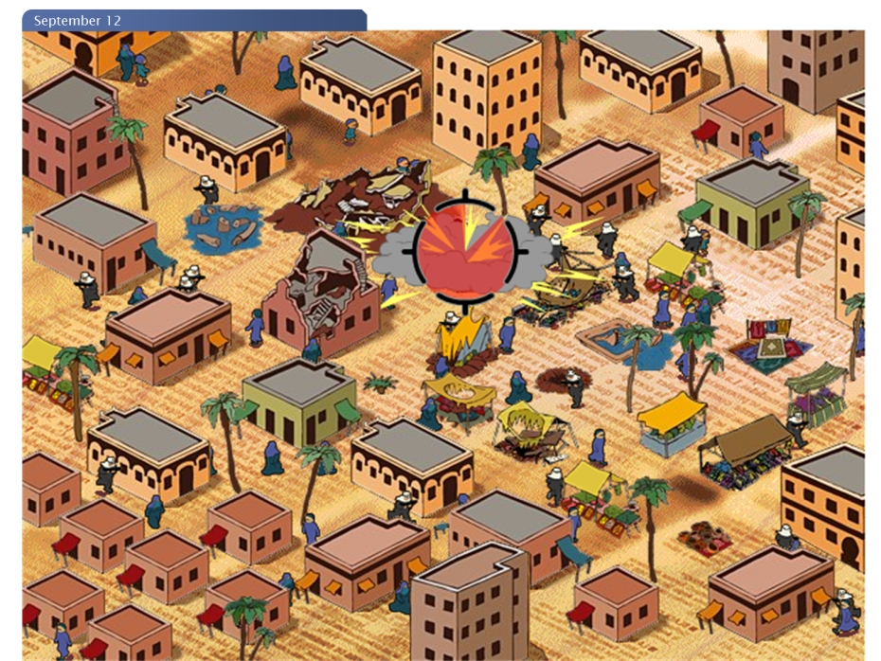

September 12th: “game” used to deliver an anti-war message

Slide 60
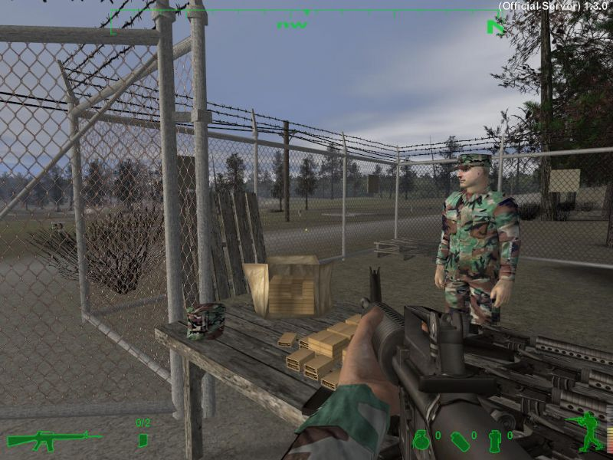

And speaking of war, this game is America’s Army—used, funded, and approved by the US government and developed by the US army to train soldiers (and attract new ones). The US army readily admits the game is a “propaganda device.” Available for free download.

Slide 61



This War of Mine (2016) focused on survival in a wartorn country, Valiant Hearts (2014) was famous for its tender narrative about friendship, while Spec Ops The Line shows the psychological horrors of war inflicted on its soldiers (2012)

Slide 62

"Super Columbine Massacre RPG!" (trailer) - YouTube

Slide 63
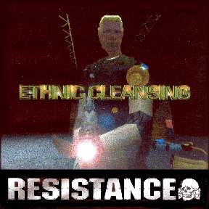

Propaganda
“[racist] games use modern technology to seduce young people who are attracted and addicted to games, into bigotry, prejudice and anti-Semitism," Foxman said. "They piggyback on the popularity of games and are a perversion of a well-meaning entertainment vehicle."
Special Forces: Hezbollah
Ethnic Cleansing: “The protagonist (the player can choose either a skinhead or a Klansman) runs through a ghetto killing black people and Latinos, before descending into a subway system to kill Jews.”

Slide 64
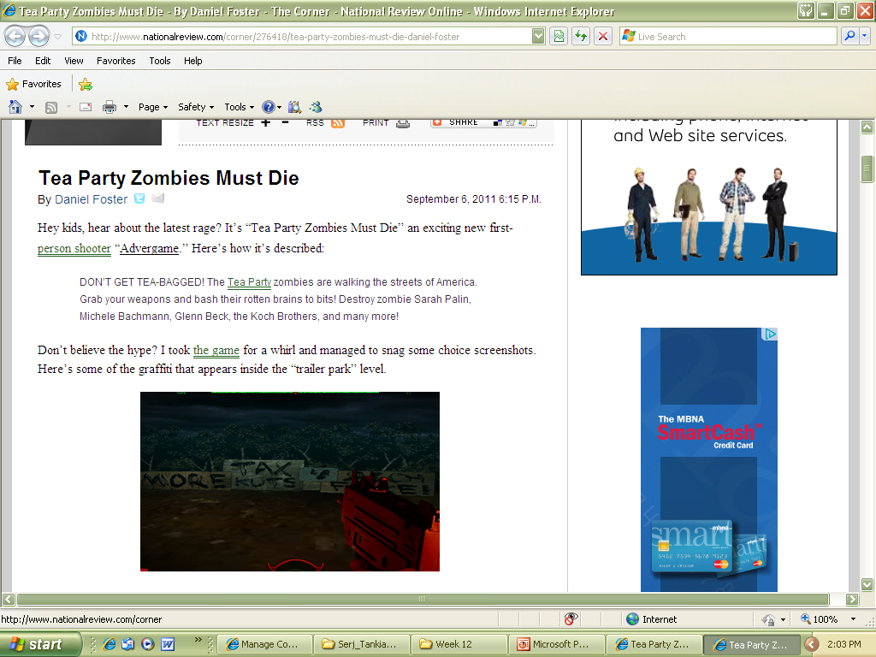
'Tea Party Zombies Must Die' Video Game Lets Players Kill Off Conservatives
Tea Party Zombies' Video Game Youtube

Slide 65


Advertainment
A fusion of advertising and entertainment: video games used for marketing purposes.

Slide 66




Slide 67
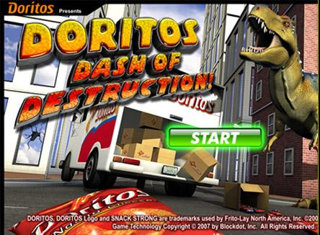

Splinter Cell: Chaos Theory

Slide 68

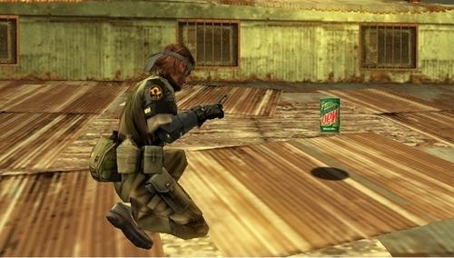

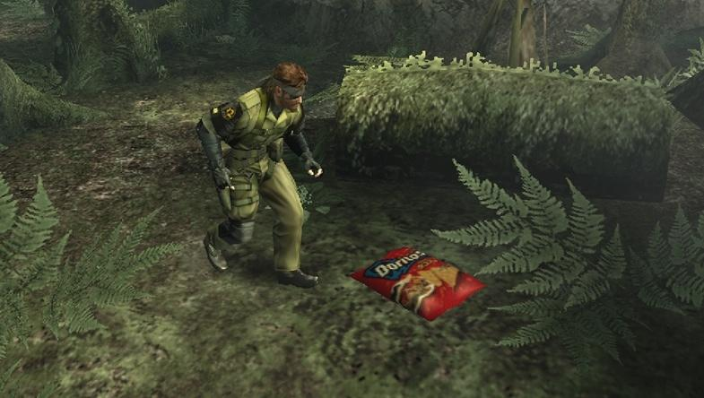
Alan Wake
Metal Gear Solid: Peace Walker

Slide 69

Homefront: a game landscape littered with so many Hooters and White Castles you’d swear they were integral to the narrative.

Slide 70



Pikiman 2
Phantasy Star Portable 2

Slide 71


Burnout: Paradise
The Obama campaign purchased space in Burnout Paradise and nine other titles by Electronic Arts for 44k each.
Even if the average gamer wasn’t going to vote, the stunt got a ton of publicity.

Slide 72
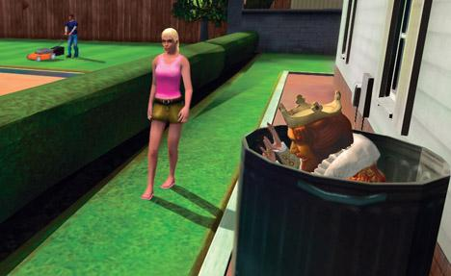

YouTube - Sneak King for Xbox 360 Trailer
The player takes control of The King, the mascot for Burger King, attempting to sneak around and deliver Burger King meals to hungry people, whoever they may be. Gamer points are rewarded for achieving certain goals or style.

Slide 73


Kim Kardashian: Hollywood
Celebrity simulation?
Game is free—spend money on clothes and accessories in game.
Beating 'Kim Kardashian: Hollywood' Reveals The Sad Truths Of Celebrity Life

Slide 74
Product Placement
Spending on in-game advertising and product placement was $56 million in 2005 (http://www.msnbc.msn.com/id/13960083/)
Spending for 2010 was 1 billion
Spending for 2014 projected at 2 billion
Spending for 2016 projected to be 7.2 billion
However, these are mere projections, and evidence suggests that in-game ad revenue has not grown as much as previously predicted…and now we have loot boxes so who cares?
Global ad spending in video games to top $7.2B in 2016 | GamesBeat | Games | by Dean Takahashi

Slide 75
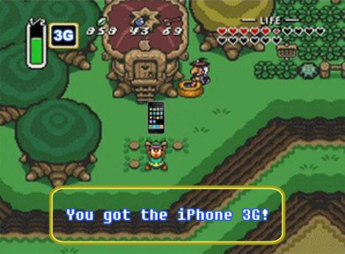
This is a joke.

Slide 76

This is not a joke.

Slide 77

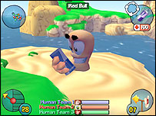
A survey by Nielsen Interactive Entertainment found that 70% of gamers actually liked in-game product placements, saying it made games more realistic.

Slide 78
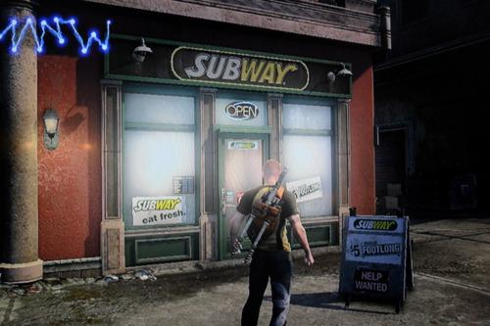
Screen shot from Infamous 2: cheap publicity, gritty realism, or corporate whoring?

Slide 79

Screenshot of Battlefield 2142, a game set in—you guessed it—2142. Won’t we have something better than Bluray by then?

Slide 80

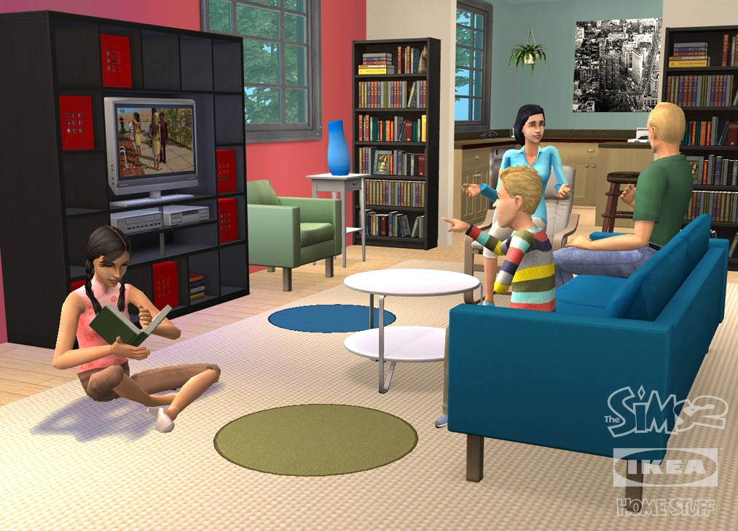


Slide 81



Darkened Skye: A game that’s gone down in legend for having a magic system that depends entirely on the player’s acquisition of….skittles.

Slide 82

Personally, in game ads take me OUT of the game; I hate it. I do, however, love the original ads featured in GTA games. Creativity without selling out, I say.
Cluckin' Bell

Slide 83

Games-For-Change
To use games and gaming mechanics to change people’s behavior (for the betterment of society).
Often highlights worthy causes.
There’s even a games-for-change festival

Slide 84

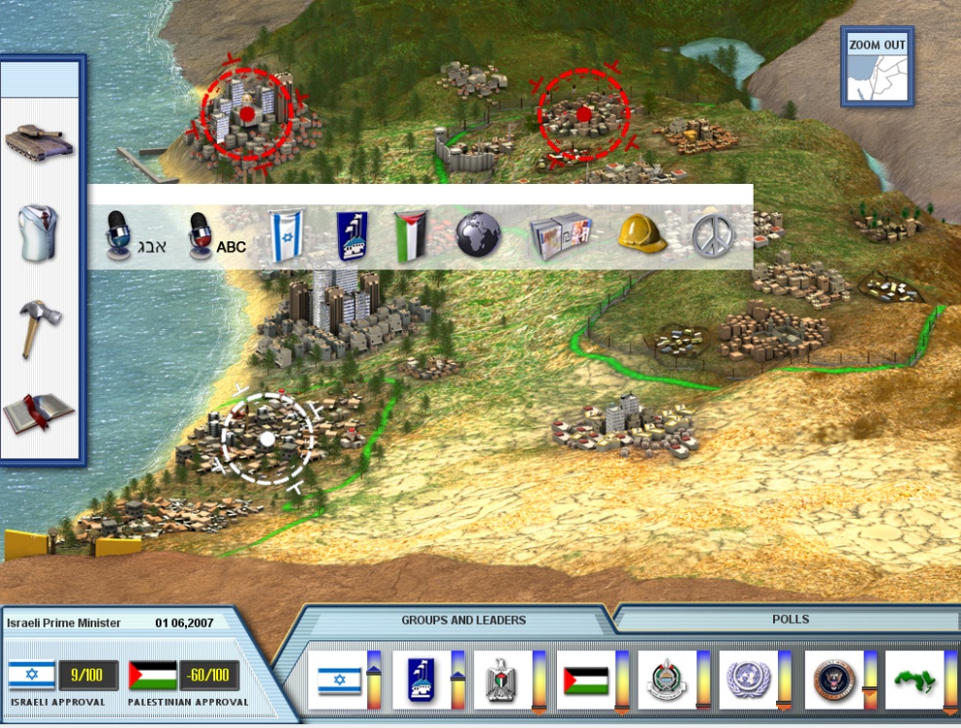
PeaceMaker
Peacemaker
PeaceMaker is inspired by real events in the Israeli-Palestinian conflict.
Be a leader and bring peace to the region before your term in office ends.
PeaceMaker is two games in one: play both the role of the Israeli Prime Minister or the Palestinian President.

Slide 85
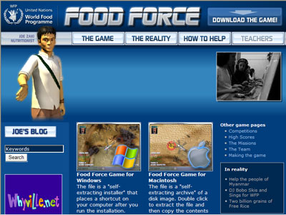
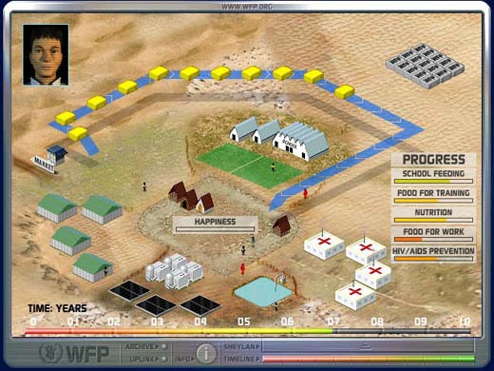

Food Force
Food Force

Slide 86
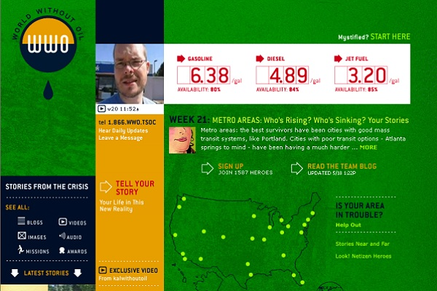
World Without Oil

Slide 87

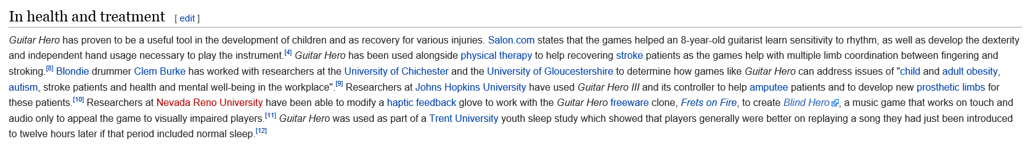
Games for Health and Therapy
Certain games—most notable Guitar Hero and the Wii—have been used in retirement communities and hospitals to promote physical fitness and physical rehabilitation
But options of developing custom games for therapy are endless.
Cosmin Mihaiu: Physical therapy is boring -- play a game instead | TED Talk | TED.com

Slide 88
Conclusion: so, do we learn?
Yes: “players can learn the same things when using video games as they do when being taught by other methods” (241).
Also, “motivation, relevance, and engagement are stronger when using computer games in education compared to traditional teaching” (241).
But the “learning” is only as good as the game’s design—and “we appear to be a long ways off from where a majority of teachers, organizations, and corporations use video games for educational purposes” (251).

Slide 89

Marble Mania Could Save Your Life!
Regarding Hand-Eye
Co-ordination
Kahol and Smith conducted studies in which trainee surgeons played a Nintendo Wii video game called Marble Mania, which requires players to develop dexterity in their hand movements to succeed at the game. http://asunews.asu.edu/20080222_wiistudy
Players showed 48 percent more improvement in their surgical techniques than the non-players.
Technology aids medical education | ASU News

Slide 90
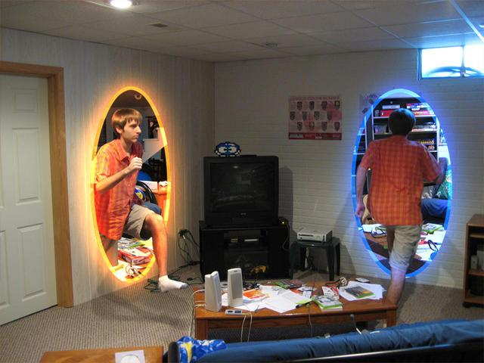

RE: Cognitive Learning Outcomes?
Problem Solving: improved, but only in relation to games—not real life.
Testing “skills transfer” to other areas of life is difficult to measure.

Slide 91
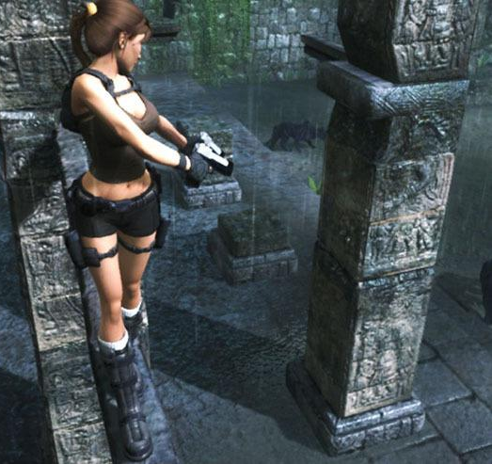

So, yeah, the problem-solving skills you learn while hunting for treasure in a video game, might help you hunt for treasure in another video game, but sure as hell aren’t going to help you in a real cave.

Slide 92

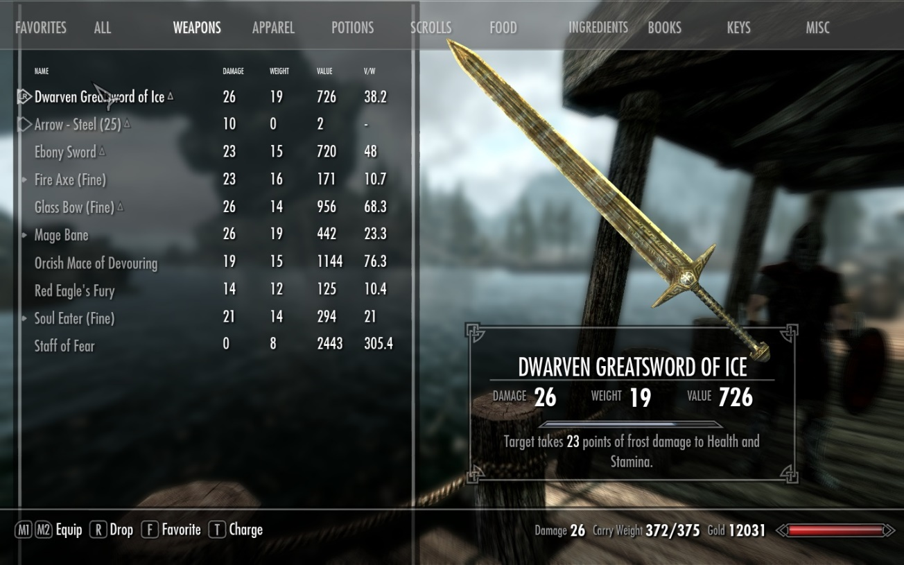
Or just because you worked hard and saved up to buy that awesome sword in Skyrim, doesn’t mean you know anything about money management in real life….(and you probably just looted corpses to get the money anyway…)

Slide 93


Put another way, let me ask you a question…
Did the motivation and skill required to beat your latest favourite video game “transfer” into you being motivated to improve the skills necessary to get a fabulous grade in your current academic program? Didn’t think so….

Slide 94



What About Driving Games?

Slide 95



And Yet…Action Gamers are better at making quick decisions…on a SCREEN!
Action video game play facilitates the development of better perceptual templates

Slide 96
Study: Pro Gamers Have Eyes of Fighter Pilot, Bodies of Elderly Chainsmokers
New study find that pro-gamers have mental acuity comparable to athletes, and visual response times almost as fast as fighter jet pilots.
One young gamer, the study noted, appeared healthy and slim, but had the lung function of a heavy smoker in his 60s.
Study: Pro Gamers Have Eyes of Fighter Pilot, Body of Elderly Chainsmoker

Slide 97

World of Warcraft skills save boy & sister from moose attack
And yet…

Slide 98

A final Conclusion
Video games are one of the most popular mediums on the planet
Harnessing the power of games to create real-world positive change mentally, physically, socially or globally is certainly achievable given how games require player agency and participation
The real question is how to combine motivation and interaction to achieve the desired results
Games as learning tools are in their infancy, but the potential is currently unlimited and untapped

